Slide 1
Understanding Variable Selection in Data Analysis
An Overview of Stepwise Selection, LASSO, and Random Forest

Slide 2
Variable selection is the process of selecting a subset of relevant predictors for use in model construction.
Why select variables?
Improves model performance
Reduces overfitting (bias)
Enhances interpretability
Variable selection

Slide 3
Methods of variable selection
One of the favored ways of selecting variables is using what we know about the disease system and removing variables that have no biological plausibility.
We did that when we removed a lot of land use variables that had no connections to NTM.
Statistical models can also be used. Today we will use stepwise selection, a LASSO method, and a Random Forest method.

Slide 4
Stepwise Selection (via AIC)
Process: Iteratively adds or removes variables based on Akaike Information Criterion (AIC).
Forward Selection: Starts with no variables and adds them one by one.
Backward Elimination: Starts with all variables and removes them one by one.
AIC: Balances model fit and complexity; lower AIC indicates a better model.

Slide 5

Advantages and Disadvantages of Stepwise Selection
Advantages:
Simple and easy to implement.
Provides a balance between model fit and complexity.
Disadvantages:
Can lead to overfitting (bias!)
May miss interactions between variables.
Computationally intensive for large datasets.

Slide 6
LASSO (Least Absolute Shrinkage and Selection Operator)
Concept: Regularization technique that performs variable selection and regularization to enhance prediction accuracy.
Mechanism: Adds a penalty equal to the absolute value of the magnitude of coefficients.
Effect: Shrinks some coefficients to zero, effectively selecting a simpler model.

Slide 7
Advantages and Disadvantages of LASSO
Advantages:
Can handle large datasets.
Automatically selects variables.
Reduces overfitting.
Disadvantages:
May not perform well if the relationship between predictors and response is not linear.
Can be computationally expensive.

Slide 8
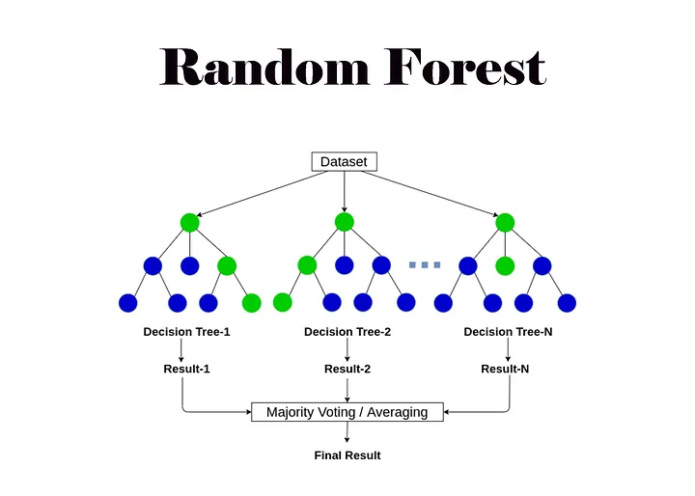
Random Forest Variable Selection
Concept: Ensemble learning method that uses multiple decision trees.
Mechanism: Measures importance of variables by looking at how much each variable improves the purity of the split.
Importance Metric: Commonly uses Gini impurity or Mean Decrease in Accuracy.

Slide 9
Advantages and Disadvantages of Random Forest
Advantages:
Handles large datasets with higher dimensionality.
Captures complex interactions between variables.
Robust to overfitting due to averaging.
Disadvantages:
Less interpretable compared to linear models.
Can be computationally intensive.

Slide 10
Comparison of Methods
Stepwise (AIC): Simple, interpretable, but can overfit.
LASSO: Regularizes and selects, good for large datasets.
Random Forest: Captures complex interactions, robust, but less interpretable.

